Slide 1
Anesthesia for Cardiac Illness
By :Biruk T

Slide 2


Slide 3
Objectives
At the end of this session the students will able
explain functional anatomy of heart
Describe pathophysiology of common valvular cardiac lesion
Describe anesthesia consideration of VHD
Discuss perioperative approach to cardiac patients
Identify risk factors for perioperative mortality and morbidity for cardiac patients coming for cardiac surgery and non cardiac surgery

Slide 4
Cont…
Describe pathophysiology of congenital heart disease
Explain anesthesia management for CHD
Discuss anesthesia consideration for IHD
Describe anesthesia management for cardiopulmonary by pass

Slide 5
Outline
Introduction
Functional Anatomy
Heart failure pathophysiology
Perioperative anesthesia approach
IHD and anesthesia management
VHD and anesthesia management
CHD and anesthesia management
Anesthesia for CPB

Slide 6
Key 1
The heart is an electrically self-actuated, phasic, variable speed, hydraulic pump composed of two dual-component, elastic muscular chambers, each consisting of an atrium and a ventricle, connected in series that simultaneously provide an equal quantity of blood to the pulmonary and systemic circulations.

Slide 7
Cont….
Cardiovascular complications account for 25% to 50% of deaths following noncardiac surgery.
Hypertensive, ischemic, congenital, and VHD— are among the medical illnesses most frequently encountered in anesthetic practice and are a major cause of perioperative morbidity and mortality

Slide 8
Cont….
Management of patients with these diseases continues to challenge the anesthetist. Why?
The adrenergic response to surgical stimulation and the circulatory effects of
Anesthetic agents
ET tube intubation
Notes:
Decreased sympathetic activity as a consequence of the anesthetized state can lead to acute circulatory collapse.

Slide 9
Cont….
Blood loss
PPV
Fluid shifts and alterations in body T⁰ impose additional burdens on an often already compromised cardiovascular system.
Notes:
Even anesthetics that have no direct circulatory effects may cause apparent circulatory depression in severely compromised patients who are dependent on the enhanced sympathetic activity Xic of HF or acute blood loss.

Slide 10
Cont…
Good anesthetic management of patients with cardiovascular disease requires a thorough knowledge of
Normal cardiac anatomy & physiology
The hemodynamic effects of the various anesthetic agents
Pathophysiology and treatment of the CVDs.

Slide 11
Cont…..
What does the normal structure of the heart look like?
- Chambers?
- Valves?
- Layers?
- Septum?
- Blood Circulation?

Slide 12
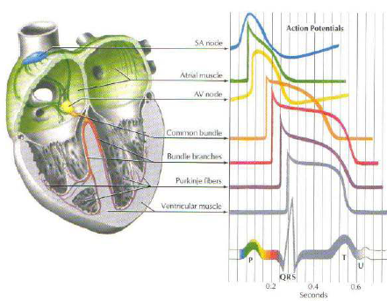
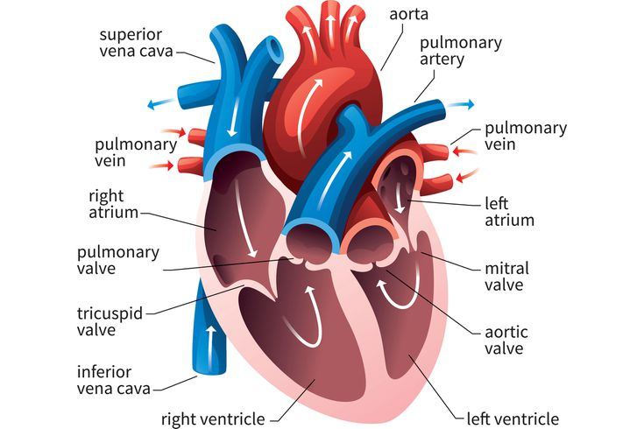
Functional anatomy of heart

Slide 13
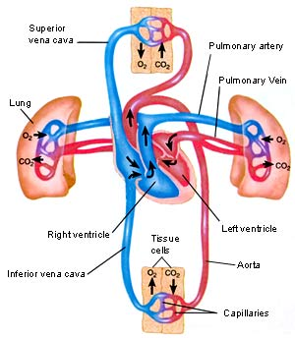
Functional anatomy of heart

Slide 14
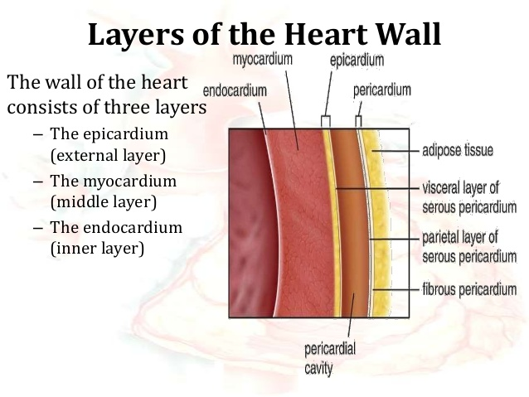
Cont….

Slide 15
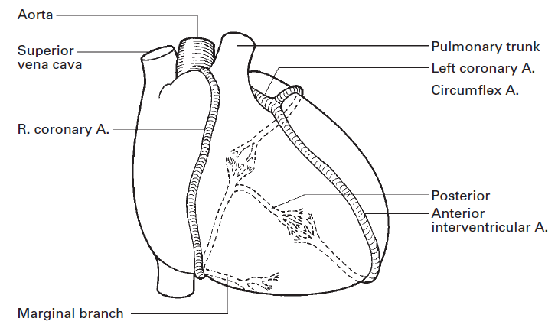
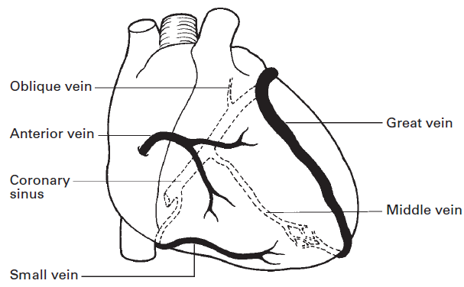

Slide 16
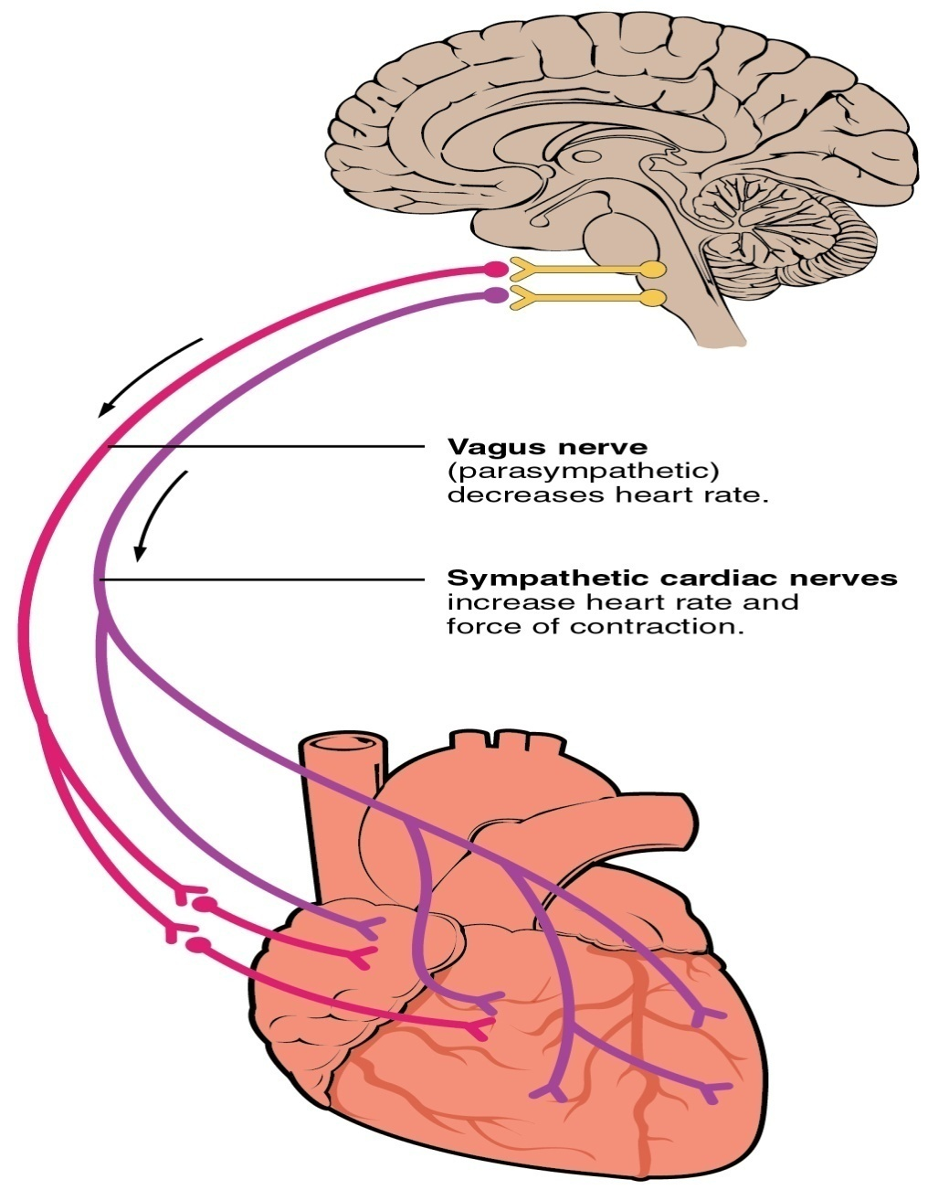
vagus (cardio-inhibitor)
Cervical and upper thoracic sympathetic ganglia (cardio-accelerator) by way of the superficial and deep cardiac plexuses

Slide 17

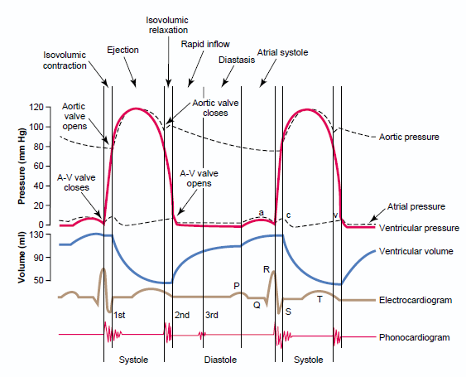

Slide 18
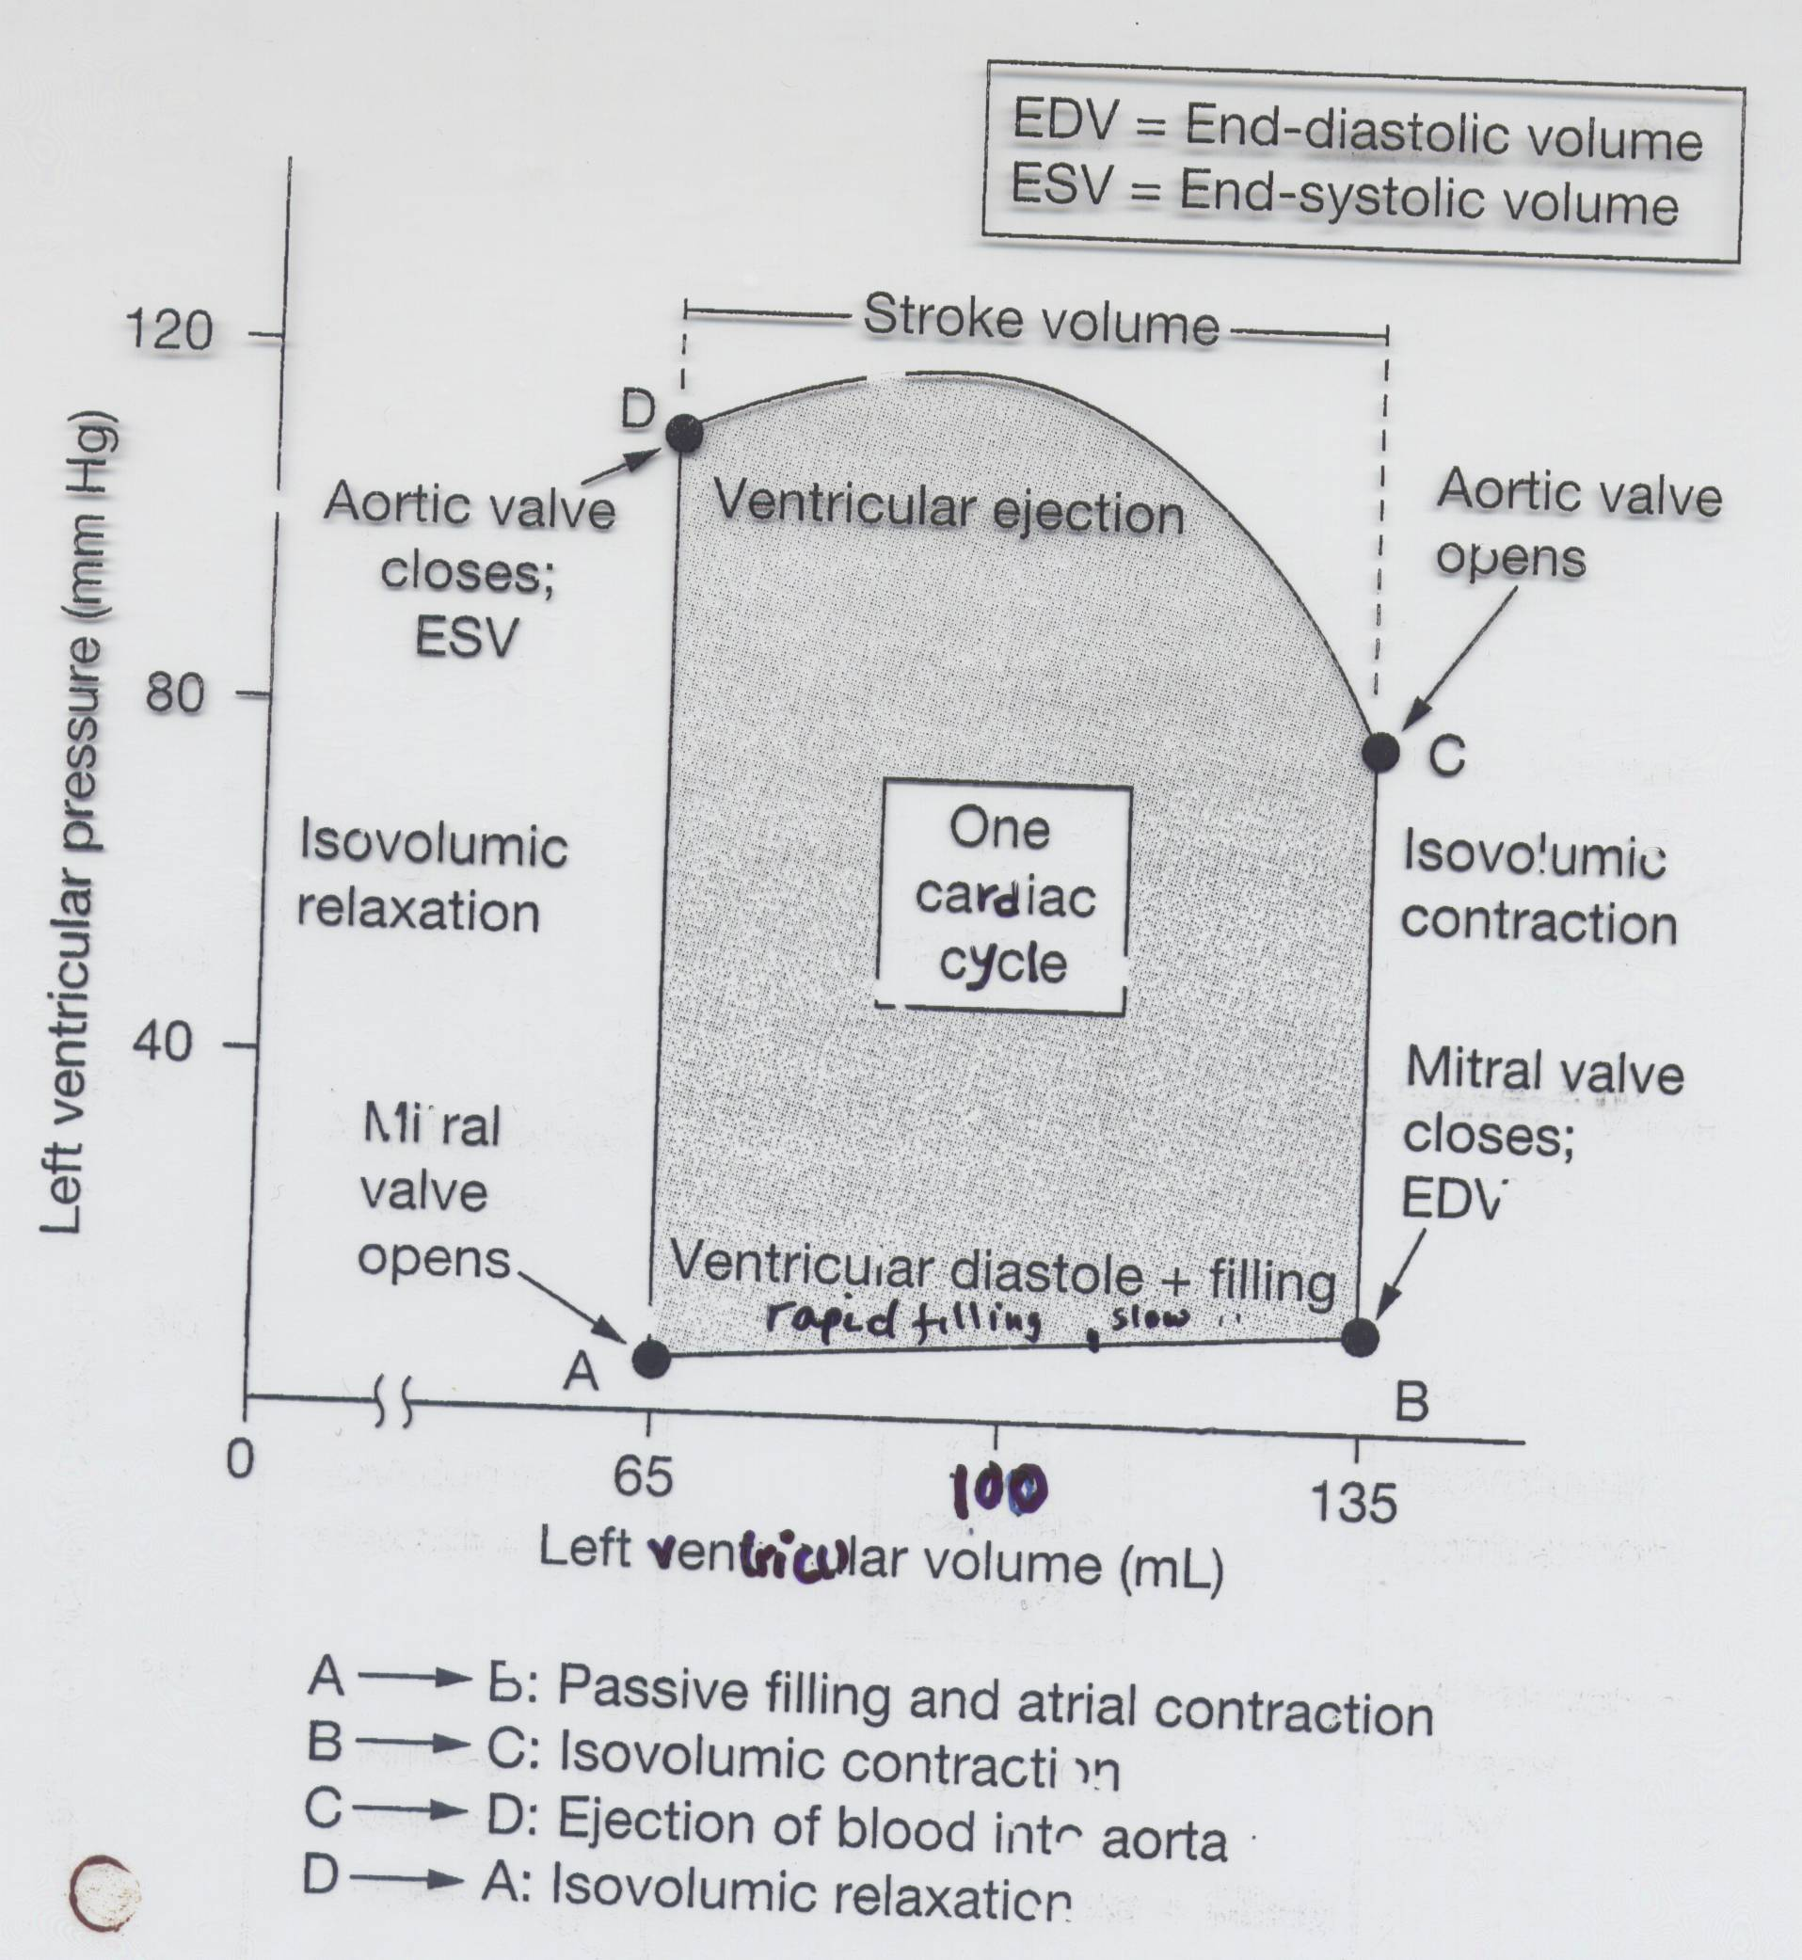
Notes:
This graph depicts LVPV Relationship during cardiac cycle.
A: End systolic volume
B: End diastolic volume

Slide 19
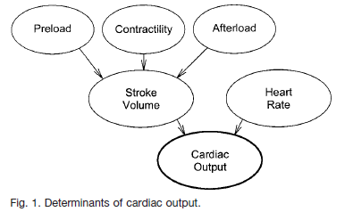
Factors affecting cardiac out put
Notes:
t failure: systolic dysfunction and diastolic dysfunction. The most common causes of systolic dysfunction (defined by a left-ventricular ejection fraction of 50%) are ischemic heart disease, idiopathic dilated cardiomyopathy, hypertension, and valvular heart disease. Diastolic dysfunction (defined as dysfunction of left-ventricular filling with preserved systolic function) may occur in up to 40–50% of patients with heart failure

Slide 20
Anesthesia for heart failure
What is HF?
a complex clinical syndrome characterized by impaired ventricular performance, exercise intolerance, and a high incidence of ventricular arrhythmias.
HF may occur suddenly or develop gradually and is the final common pathway of a variety of primary CVD entities

Slide 21
Causes
Decreased contractile function
a. Valvular heart disease
b. Coronary Heart Disease : Myocardial ischemia
c. Myocardial Disease : Cardiomyopathy, Myocarditis
Increased after load
a. Acute systemic hypertension
Abnormalities in preload
a. Excessive preload
b. Reduced preload
Reduced compliance states:
Constrictive pericarditis
Restrictive cardiomyopathy

Slide 22
HEART FAILS precipitating factors
H- Hypertension (systemic)
E- Endocarditis (infections)
A- Anemia
R- Rheumatic fever and myocarditis
T- Thyrotoxicosis and pregnancy
F- Fever (infections)
A- Arrhythmia
I- infarction (myocardial)
L- Lung infection
E- Embolism (pulmonary)
S- Stress (emotional, physical, environment, dietary, fluid excess)

Slide 23
Clinical manifestations
Progressive dyspnea
Orthopnea and paroxysmal nocturnal dyspnea (PND)
Cough productive of pink, frothy sputum
Peripheral edema and ascites
Nonspecific complaints include the following: easy fatigability, light headedness,malaise anxiety abdominal pain, nausea

Slide 24
Physical findings
Tachycardia and Tachypnea
Jugular venous distention (JVD)
Pulsus alternans (alternating weak and strong pulse indicative of depressed left ventricle [LV] function
Wheezing or rales may be heard on lung auscultation and there may be bilateral basal dullness

Slide 25
Physical findings
Apical impulse frequently is displaced laterally
Cardiac auscultation may reveal aortic or mitral valvular abnormalities, S3 or S4
Skin may be diaphoretic or cold, gray, and cyanotic
Lower extremity edema also may be noted, especially in the subacute process

Slide 26
Common drug & side effect
Diuretics – azotemia, hypokalemia & metabolic alkalosis
Spironolactone- hyperkalemia & gynecomastia
Digoxin – electrolyte disturbance toxicity with hypokalemia
ACEI – acute renal failure, angioedema,
Beta blockers- brady cardia, hypotension
Vasodilators (hydralazine) - hypotension

Slide 27
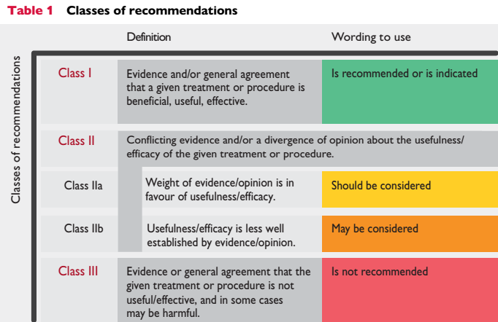

Slide 28
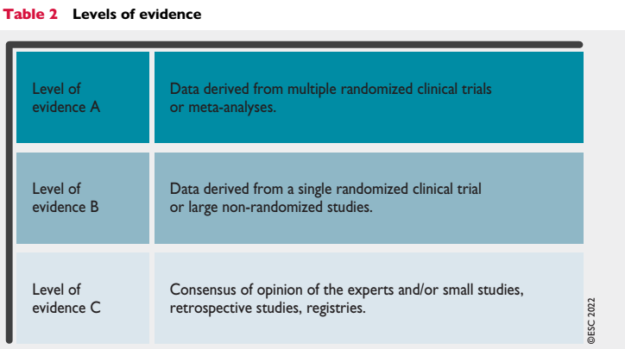

Slide 29
Cont…
Perioperative risk is proportional both to the severity of the patient’s HF and the surgical risk.
Close attention to fluid balance and CVs stability is essential to prevent an acute exacerbation of HF or other major CVs morbidity

Slide 30
Etiology
CAD
hypertension
Diabetic
VHD
Age
non‐ischaemic myopathies

Slide 31
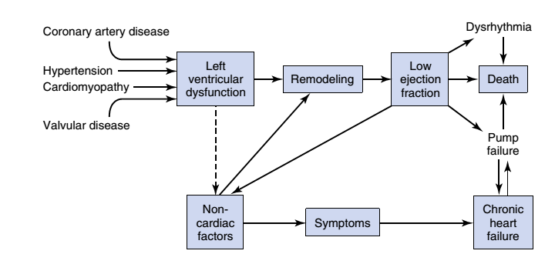

Slide 32
Cont…
Pathophysiologic mechanisms of HF:
Volume overload
Pressure overload
Myocardial loss
Impaired ventricular filling

Slide 33
Pathophysiology
Structural changes :
The chambers enlargement, increased wall thickness and stiffness.
fibrosis and myocellular hypertrophy.
2. Functional changes
affect both diastole (relaxation) and systole (contraction).

Slide 34
Cont….
HF can be broadly subdivided into two distinct forms
Diastolic dysfunction or diastolic heart failure
affects the left ventricle.
systolic dysfunction or systolic heart failure(common)
affect either ventricle but failure of the left heart is more common.

Slide 35
Low-output heart failure
Causes of low-output heart failure are
CAD
Cardiomyopathy
Hypertension
Valvular disease &
Pericardial disease

Slide 36
High cardiac output
Causes of high cardiac output HF include
Anemia
Pregnancy
Arteriovenous fistulas
Severe hyperthyroidism
Beriberi
Paget’s disease

Slide 37
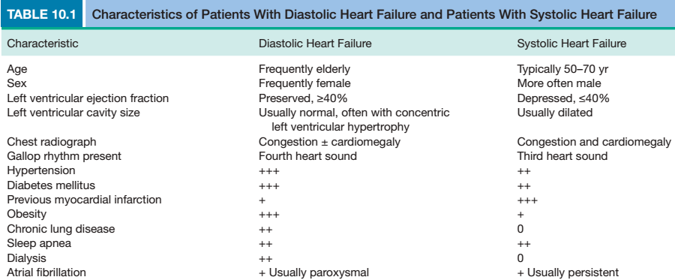

Slide 38
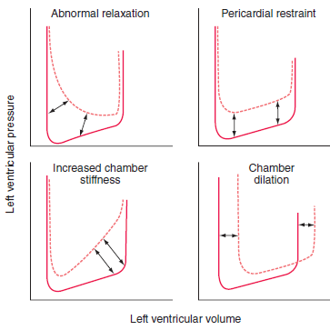
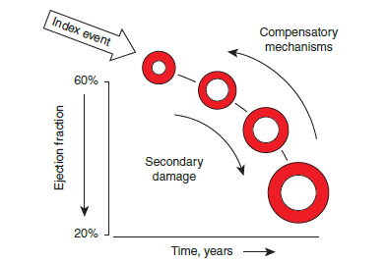
Diastolic dysfunction mechanism
HF in depressed EF

Slide 39
Adaptive mechanisms
In the failing ventricle, various adaptive mechanisms are initiated to help maintain a normal cardiac output
Increases in SV according to the Frank-Starling relationship
Activation of the SNS
Alterations in the inotropic state, heart rate, and afterload
Humorally mediated responses

Slide 40
Clinical picture
The hallmark of AHF is congestion
by weight gain, peripheral edema, jugular vein distension
hepatic enlargement, and/or pain, hepato-jugular reflux
ascites or pulmonary congestion, characterized by dyspnoea of varying severity and lung rales.
Notes:
The hallmark of AHF is congestion. Congestion is either peripheral, characterized by

Slide 41
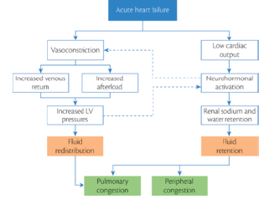
Cont….

Slide 42
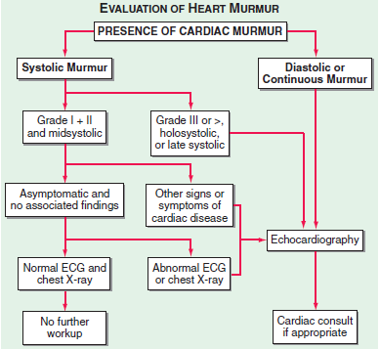
DIAGNOSIS
History and PE
Assessment of heart murmur
Routine lab test
Biomarker (BNP)
Assessment of functional impairment(echo,ECG)

Slide 43
Management
Volume management
Diruretic
Pressure management
ca channel or B-blocker
Vasculary therapy
vasodilator
Maintain atrial contractility and prevent tachycardia
Inotropic therapy

Slide 44
Pre op assessment
Hx: Evidence of decompensation within 6 months of surgery is associated with increased risk.
An ejection fraction (EF).
Metabolic equivalent test (MET):
Risk stratification via different cardiac risk indexes is crucial
Notes:
Patients unable to sustain 4 ‘metabolic equivalents’ (climbing a flight of stairs) are particularly at risk for perioperative complications

Slide 45
Cont….
Active cardiac conditions for which the patient should undergo evaluation and treatment before noncardiac surgery
- Unstable coronary syndromes
- Decompensated HF
- Significant arrhythmias
- Severe Valvular disease

Slide 46
Estimating LV impairments from EF
Ejection fraction 40-50% | Mild LV impairment
Ejection fraction 30-40% | Moderate LV impairment
Ejection fraction < 30% | Severe LV impairment
Notes:
Normal:60-80%

Slide 47
Investigations;
CBC : Anaemia and electrolyte disturbance (especially for patients taking diuretics) should be identified and treated.
ECG: Check for arrhythmias, cardiac axis, QRS morphology...
CXR:- cardiomegaly, pleural effusions
Echocardiogram : Transthoracic echocardiogram (EF, Valve D. …)
Notes:
Other blood tests which may reveal aggravating factors include liver and thyroid function tests and glucose.

Slide 48
Induction and intra op management
Hemodynamic goals :
preserving CO
minimizing myocardial work

Slide 49
Preserving cardiac out put:
Increase the central venous pressure
Avoid tachycardia
Avoid /treat /control Arrythmias ESP. atrial fibrillation
Use IV agents which have sympathomimetic effects for induction .

Slide 50
Avoid hypovolemia
Vasopressor
Inotrope or phosphodiesterase inhibitors may be required for patients who decompensate in the perioperative period.

Slide 51
Minimize myocardial work load
Avoid Tachycardia by preventing factors which may precipitate tachycardia, including intubation, surgical stimulus, Hypovolaemia, anemia, hypoxia, hypercapina, post-operative pain, nausea and vomiting.
Notes:
An increased HR is more likely than systemic HTN to produce signs of myocardial ischemia

Slide 52
Opioids such as alfentanil attenuate the response to intubation.
Effective analgesia is important and use of regional techniques should be considered

Slide 53
Cont…..
Symptomatic arrhythmias should be treated, and attempts made to control heart rate to around 80 bpm
Atrial fibrillation is poorly tolerated
Elective surgery should be postponed until medical management has been optimised and risk assessed thoroughly against benefit…. (2 – 6wks)

Slide 54
Coronary artery disease Ischemic heart disease
An inadequate supply of blood and oxygen to a portion of the myocardium
An imbalance between myocardial oxygen supply and demand.
The most common cause of myocardial ischemia is atherosclerotic disease of an epicardial coronary artery (or arteries)

Slide 55
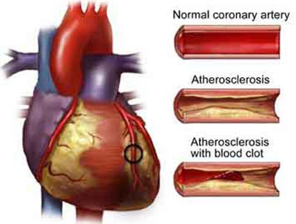
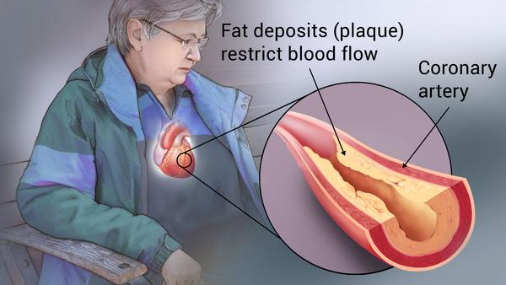
CAD

Slide 56
Cont…
The prevalence of vascular disease and ischemic heart disease increases significantly with age - in the US 30% of patients who undergo surgery annually have IHD
5% of patients >35 years of age have asymptomatic ischemic heart disease.

Slide 57
Cont….
Disease of the coronary arteries can cause
Myocardial infarction (MI)
Angina
Cardiac arrhythmias
Heart failure
Sudden death

Slide 58
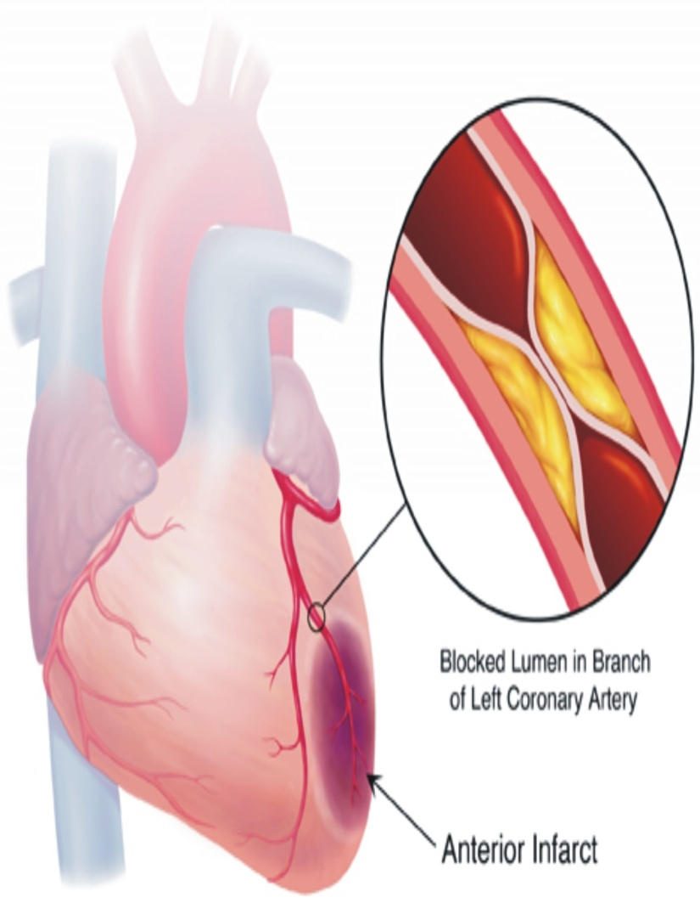
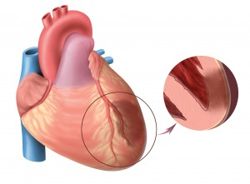
Cont……….
An inadequate blood supply to the heart muscle ( myocardial ischemia). acute coronary syndromes

Slide 59
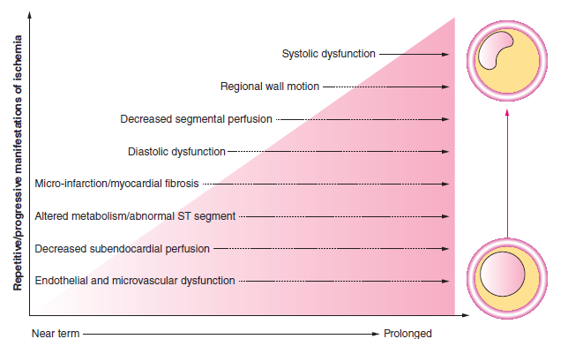

Slide 60
Cont….
What three factors determine the severity of an MI?
The level of the occlusion in the coronary artery
The length of time of the occlusion of the artery
The presence or absence of collateral circulation

Slide 61
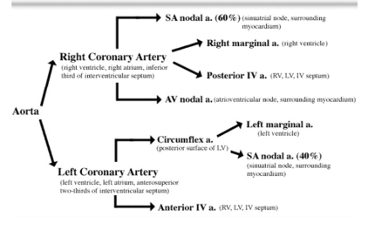
Blood supply of the Heart

Slide 62
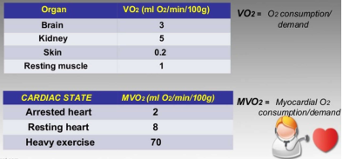
Cont....

Slide 63
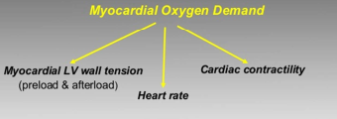
Determinant of myocardial o2 demand

Slide 64
Risk Factors for Development of IHD
Obesity
Diabetes mellitus
Cigarette smoking
Sedentary lifestyle
Genetic factors
Family history of premature ischemic heart disease
Male gender
Increasing age
Hypercholesterolemia
Hypertension
Notes:
)

Slide 65
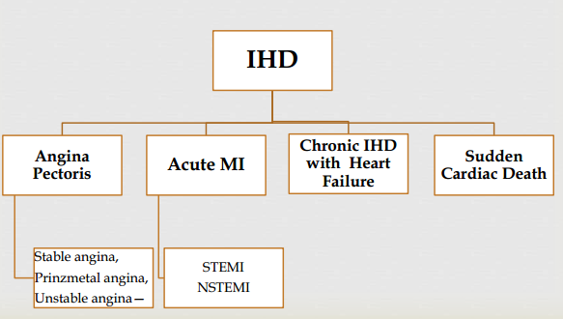
Spectrum Of IHD

Slide 66
Myocardial Infarction (MI)
"heart attack," is the death of cardiac muscle resulting from ischemia.
Region of myocardial necrosis (prolonged cessation of blood supply)
Resulted from acute thrombus at side of coronary atherosclerotic or stenosis

Slide 67
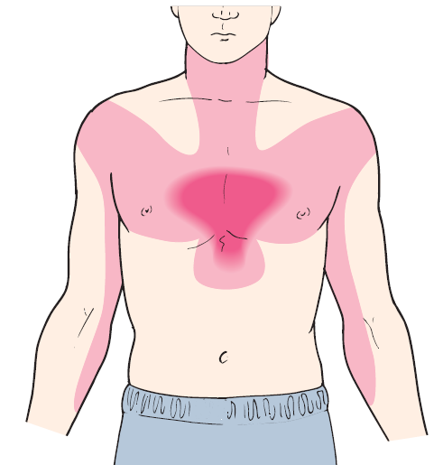
Typical symptoms of acute myocardial infarction
Sudden Chest Pain,
Shortness Of Breath,
Nausea, Vomiting,
Palpitations, Sweating
Weakness, Light-headedness
Collapse/syncope

Slide 68
Signs of AMI
Tachycardia, anxiety and restlessness
Skin pale cool and moist
Hypotension and shock
Sudden death – fatal arrhythmias (ventricular fibrillation

Slide 69
Myocardial Infarction (MI)
Diagnosis of Acute MI:
At least 2 of the following • Ischemic symptoms • Diagnostic ECG changes • Serum cardiac marker elevations

Slide 70
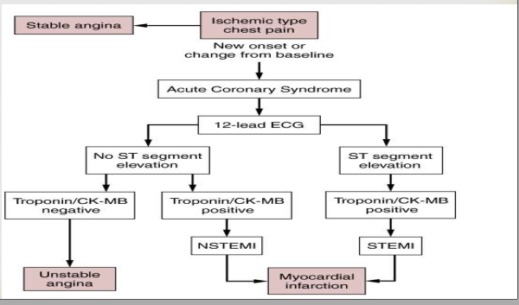
Myocardial Infarction (MI)

Slide 71
Screening & Evaluation
Goals • Identify the risk for heart disease based on risk factors. • Identify the presence and severity of heart disease (symptoms, physical findings, or diagnostic tests) . • Determine the need for preoperative interventions. • Modify the risk for perioperative adverse events.

Slide 72
Specialized Preoperative Testing
12-lead ECG:
Prominent Q waves) in 2 or more leads - old MI
ST segment depression - angina pectoris
ST-segment elevation, increased T-wave amplitude, followed by ST elevation - AMI or variant angina.
Reversible T wave inversion - angina pectoris
Notes:
>1/3 of the QRS complex length)
>1 mm from baseline in case

Slide 73
Cont….
Exercise ECG -for detecting signs of myocardial ischemia as well as for evaluation of exercise capacity
Contraindications: • Severe AS • Severe hypotension • Acute myocarditis • Uncontrolled HF • Infective Endocarditis

Slide 74
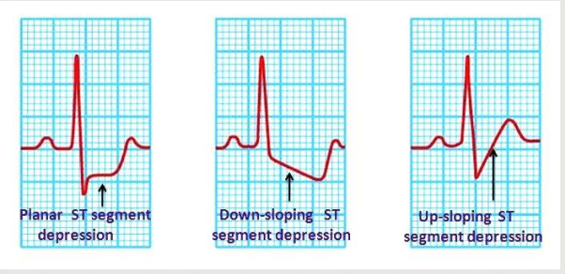
ECG Changes in Stable Angina: Transient ST depression

Slide 75
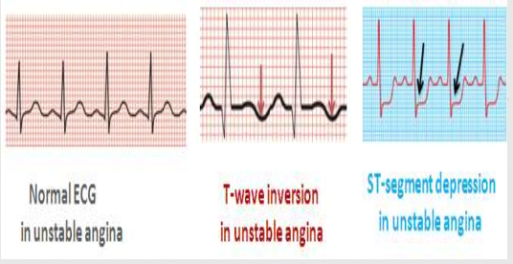
ECG Changes in Unstable Angina: Transient ST depression / T wave inversion

Slide 76
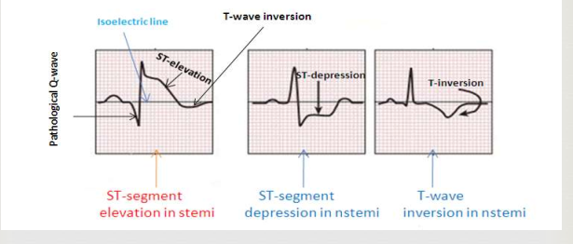

Slide 77
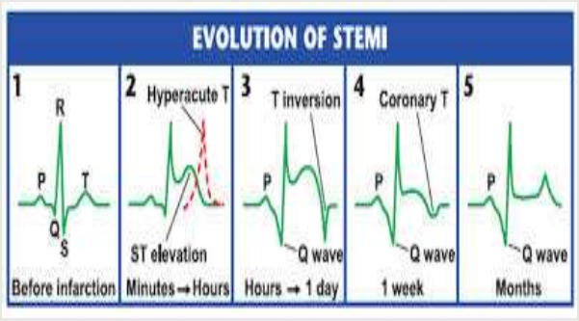

Slide 78
CONT….
a common recommendation is to delay elective surgery, especially thoracic, upper abdominal, or other major procedures, for a period of 6 months after MI.
Most perioperative myocardial reinfarction occur in the first 48 to 72 hrs postoperatively.
Perioperative β-blockade started 7 to 30 days before surgery and continued for 30 days postoperatively has been shown to reduce the risk for cardiac morbidity (MI or cardiac death) by 90%.

Slide 79
Echocardiography
localize the obstructive coronary lesions.
used to assess global cardiac function -
To assess regional wall motion abnormalities & detect the presence of previous myocardial injury.

Slide 80
Stress echocardiography:
This is used with pharmacologic induction of cardiac stress (dobutamine) or exercise to look at LV segmental wall function at rest & with stress.
This can be also used to differentiate between viable (hibernating, stunned) & nonviable (infarcted) myocardial segments

Slide 81
Other imagings…
Nuclear Stress Imaging
Coronary Angiography
Positron Emission Tomography

Slide 82
Management Prior to Surgery
Three options
Revascularization by surgery (CABG)
Revascularization by PCI
Optimal Medical Management

Slide 83
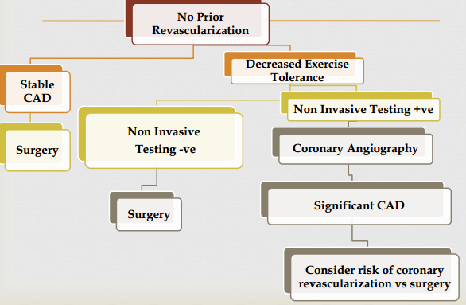
High /Intermediate risk Surgery + Moderate Clinical Risk Factors

Slide 84
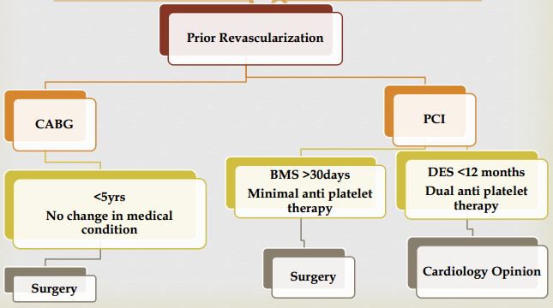
High /Intermediate risk Surgery + Moderate – Minor Clinical Risk Factors

Slide 85
Pharmacological Management (ACC/AHA + European Guidelines)
Perioperative beta-blocker therapy
Perioperative statin therapy
ACE inhibitors
Antiplatelet agents

Slide 86
Anesthesia management
Goal
maintenance of a favorable balance between myocardial O₂ requirements and myocardial O₂ delivery
Avoid adrenergic surge leading to an imbalance in myocardial o2 supply – demand ratio
Preserve CO

Slide 87
Causes Of Myocardial O2 Imbalance
1. Decreased O2 supply
Decreased blood coronary flow
tachycardia (decreased diastolic perfusion time)
hypotension (esp diastolic BP)
hypocapnia (coronary vaso constriction)

Slide 88
Cont….
Decreased O2 content & availability
anemia
Hypoxemia
ODC shift to left

Slide 89
Cont…
2. Increased O2 demand • tachycardia • increased wall tension • increased preload • increased after load • increased myocardial contractility

Slide 90
Management….
Avoid Any event associated with
Persistent Tachycardia
Systolic HTN
Arterial hypoxemia or
Diastolic hypotension

Slide 91
Management….
Pre Medication
Benzodiazepines –
Intravenous narcotics (e.g. Fentanyl)
Induction agent:
Etomidate: Causes minimal hemodynamic changes and is a good choice for patients with poor cardiac reserve.
Ketamine -best to be avoided
Notes:
Induction of anesthesia is acceptably accomplished with the IV administration of rapidly acting drugs

Slide 92
Perioperative Monitoring
ECG
PA catheter
CVP
Transesophageal echocardiography:
-Most sensitive

Slide 93
Cont….
Intubation: To be facilitated by the use of succinylcholine or a NDMR.
Blunting of hemodynamic response to tracheal intubation by • Keeping the duration short (<15s) • Use of laryngotracheal Lidocaine, intravenous lidocaine, esmolol, fentanyl, dexmedetomidine.

Slide 94
Maintenance
The choice of anesthesia is often based on the patient’s left ventricular function.
AHA guidelines recommend volatile anesthetic agents for maintenance of anesthesia in patients with IHD in a hemodynamically stable patient with no evidence of CHF

Slide 95
Maintenance …..
Isoflorane - reduces coronary vascular resistance
Opoids
Muscle relaxant (avoid pancronium)
Notes:
Opioids may be selected as the primary anesthetic in patients with compromised LV function.

Slide 96
Cont…
Regional vs GA
RA may be preferred to GA if possible
Preoperative epidural analgesia may be considered to decrease the incidence of preoperative adverse cardiac events

Slide 97
Post Operative And Long-term Management
Early extubation
hemodynamic alterations must be blunted by β-blocker or combined α- and β-blockers such as labetalol, lidoccaine or fentanyl
Proper pain control.
Continuous ECG monitoring with ST-segment analysis
Supplemental O2 to maintain adequate oxygen saturation is important.
Avoid & treat shivering.
Prevent. hypoxemia, hypercarbia, hypovolemia

Slide 98
General Evaluation of Patients with CVS
CVD accounts for the majority of perioperative deaths.
Preoperative detection, investigation, treatment, and risk assessment helps minimize perioperative morbidity and mortality.

Slide 99
Cont….
Regardless of the lesion or its cause, preoperative evaluation should be primarily concerned with:
Determining the severity of the lesion and its hemodynamic significance
Residual ventricular function
The presence of secondary effects on organ function
Notes:
Concomitant coronary artery disease should be evaluated-Myocardial ischemia may present in patients with severe aortic stenosis or regurgitation.

Slide 100
History:
Focus on symptoms related to ventricular functions
evidence of current or recent decompensation
Review of medication patients took
End organ damage
Notes:
ventQuestions should concern exercise tolerance, fatigability, and pedal edema and shortness of breath in general, when lying flat, or at nightInquire about chest pains and neurologic symptoms prior to procedures

Slide 101
Functional capacity
Exercise tolerance is a major predictor of perioperative risk.
Ability to exercise is an excellent indicator of ‘cardiovascular fitness’
It is usually expressed in metabolic equivalents(METs) on a scale defined by the Duke Activity Status Index.
Pts who cannot sustain 4METs of physical activity frequently have adverse outcomes following high risk surgery.

Slide 102
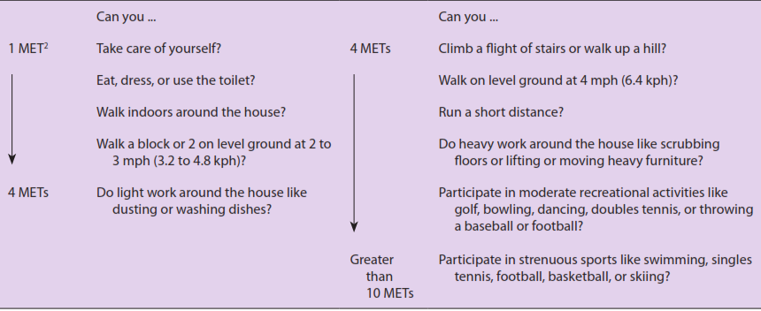

Slide 104
CONT….
Functional capacity is classified as:
Excellent—> 10 METs
Good—7–10 METS
Moderate—4–6 METs
Poor-<4 METS
Notes:
N.B. perioperative cardiac and long-term risk is higher in patients unable to perform 4 METs of work during daily activities

Slide 105
NYHA classification
Class I: no limitation of physical activity. Ordinary physical activity does not cause symptoms of heart failure.
Class II: slight limitation of physical activity.
Comfortable at rest, but ordinary physical activity results in symptoms of heart failure.

Slide 106
Cont….
Class III: marked limitation of physical activity.
Comfortable at rest, but less than ordinary activity causes symptoms of heart failure.
Class IV: unable to carry out any physical activity without symptoms of HF, or symptoms of heart failure at rest

Slide 107
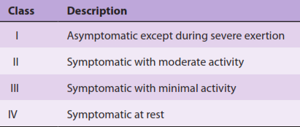
Modified New York Association functional classification of heart disease

Slide 108
Physical examination
The most important signs of congestive heart failure
Left –sided heart failure -S 3 gallop or pulmonary rales)
Right sided heart failure --jugular venous distention, hepatojugular reflux, hepatosplenomegaly, or pedal edema

Slide 109
Cont…
Heart murmurs
Determining the cause of cardiac murmurs
Distinguishing between significant murmurs and those that are clinically unimportant

Slide 110
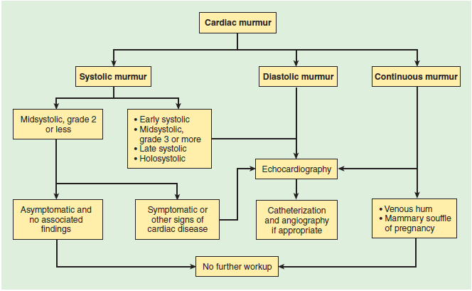
Cont…

Slide 111
Laboratory Evaluation
LFT --- right sided heart failure
ABG– pulmonary edema
Coagulation profile (PTT,PT or INR)- for pts on warfarin or heparin
Blood tests: Anemia and electrolyte disturbance (especially for patients taking diuretics)

Slide 112
Investigation
CXR
Cardiomegally and Calcification of the aortic valve
Post-stenotic dilation of the ascending aorta
ECG
LVH
Pseudo infarction/ischemia pattern

Slide 113
Special diagnostic studies:
Echocardiography, angiography, and cardiac catheterization provide significant diagnostic and prognostic information about Valvular lesions.

Slide 114
Echocardiography (LV function)
Modern echo machines generate values for ejection fraction ( normal range 60-80%)
Ejection fraction: 40-50 % → mild LV impairment
Ejection fraction: 30-40% → moderate LV impairment
Ejection fraction: <30% → severe LV impairment
Trans valvular pressure gradient
Area of the valves and calcification
Ventricular wall thickness and chamber size

Slide 115
^{cont….}
Doppler:
Flow, severity of stenosis
Cardiac catheterization
The measurement of pressures and cardiac output

Slide 116
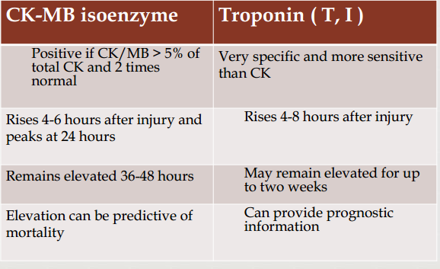
Cardiac Markers:

Slide 117
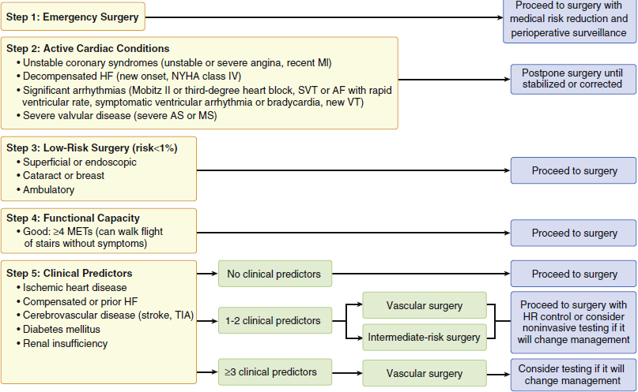
Simplified cardiac evaluation for noncardiac surgery

Slide 118
Risk Stratification indices
AIM: Identify patients at increased risk so as to manage them with pharmacological and other perioperative interventions that can lessen the risk and severity of perioperative cardiac events.

Slide 119
Lee’s Revised Cardiac Risk Index (RCI)
A tool used estimate predict patients risk of developing postoperative:
MI
Pulmonary edema
Ventricular fibrillation
Cardiac arrest
Compete heart block

Slide 120
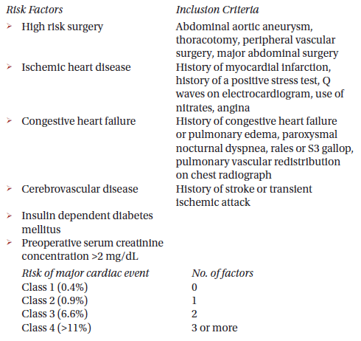
Lee’s Revised Cardiac Risk Index:
Notes:
Uses 6 independent predictors of major cardiac complications for patients undergoing elective non cardiac surgery.

Slide 121
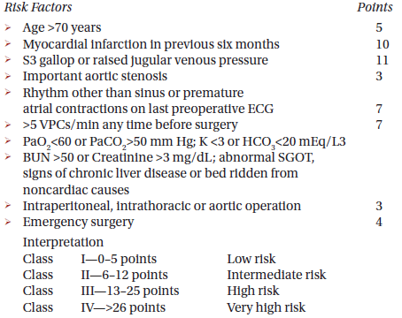
Goldman Cardiac Risk Index

Slide 122
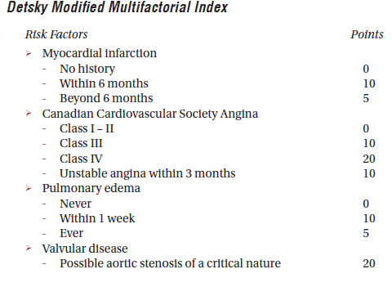

Slide 123
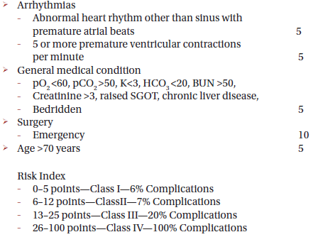
Cont….

Slide 124
The ACC/AHA guidelines integrate risk stratification according to:
Clinical risk factors & ECG review.
Functional Capacity.
Surgery specific risk factors.

Slide 125
Clinical Predictors of Increased Perioperative Cardiovascular risk
Major
Unstable coronary syndromes
Acute / Recent MI
Unstable/ Severe Angina
Decompensated Heart Failure
High grade AV-block
Symptomatic Ventricular Dysrhythmias
Severe Valvular Heart Disease

Slide 126
Clinical Predictors of Increased Perioperative Cardiovascular risk
Minor
Age>70
ECG: LVH,LBBB ST-T abnormalities
Low functional capacity
Hx of CVA/HTN
Intermediate
Stable Angina
Previous MI (history/ECG)
Compensated or previous heart failure
DM/Renal Insufficiency

Slide 127
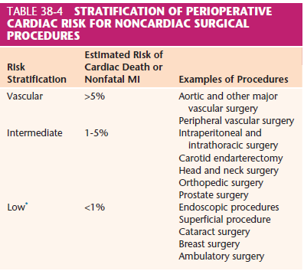
Cont….

Slide 128
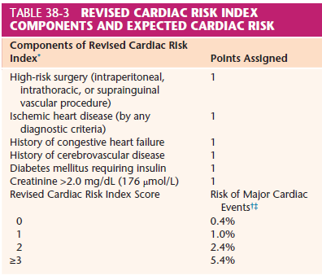
Cont…

Slide 129
Intraoperative monitoring
Standard monitoring (ECG, BP, TEMP. ,SPO2 ,ETCO2)
Invasive monitor
Arterial line
CVP
PA Catheter

Slide 130


